Slide 1


Remote Sensing Image Search and Retrieval from Large Archives
Prof. Dr. Begüm Demir
email: demir@tu-berlin.de
Chair of the Remote Sensing Image Analysis (RSiM) Group
Faculty of Electrical Engineering and Computer Science
Technische Universität Berlin

Slide 2


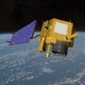
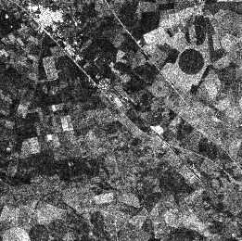
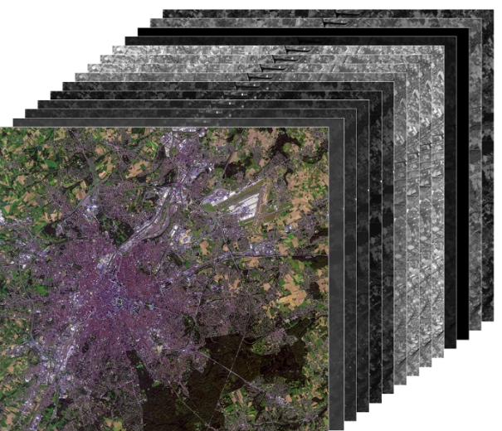
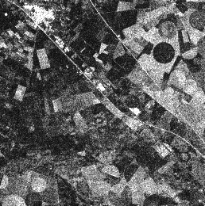
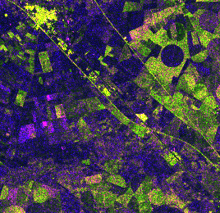
Introduction: Space Renaissance
Recent Earth Observation (EO) satellite missions have led to a significant growth of EO image archives, e.g.:
ESA’s Sentinel-1
(SAR)
ESA’s Sentinel-2
(Multispectral)
Sentinels: Europe's eyes on Earth
Fort McMurray, Canada-24/06/2016
Brussels, Belgium-08/09/2016
B. Demir
2

Slide 3
Introduction
One of the most challenging and emerging applications in remote sensing (RS) is the efficient and precise retrieval of images from large archives.
Available remote sensing image retrieval systems rely on:
Use of keywords/tags in terms of sensor type, geographical location and data acquisition time of images stored in the archives.
Content-based image retrieval (CBIR) due to its potential practical applications.
B. Demir
3

Slide 4
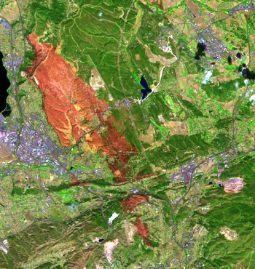

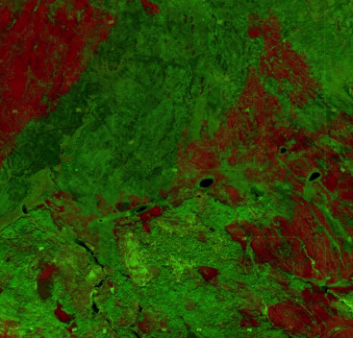
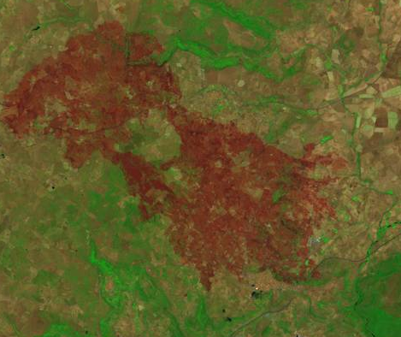
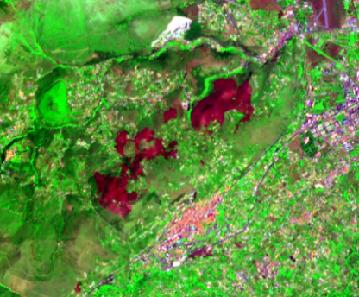
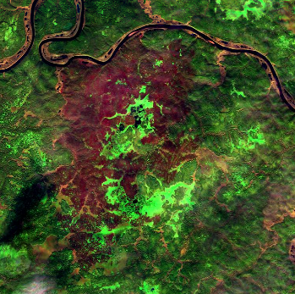
CBIR in RS: General Approach
Burned Forest
Marseille, France-22.09.2016
McMurray, Canada-30.08.2016
Sardinia, Italy-28.07.2016
Sicily, Italy-25.05.2016
Siberia, Russia-08.10.2016
B. Demir
4

Slide 5
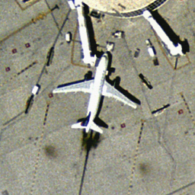
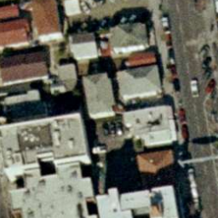
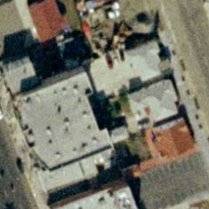
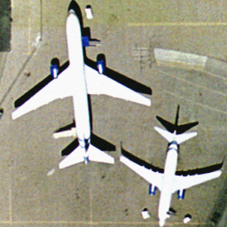
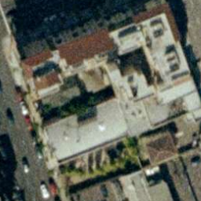
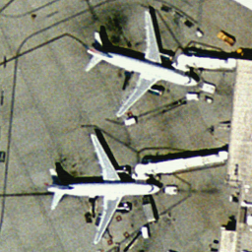
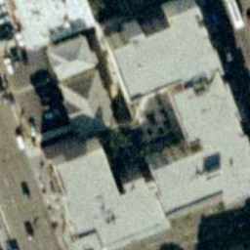
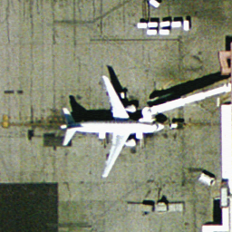
CBIR in RS: General Approach
Feature Extraction
Image
features
Query Image
RS Image Retrieval
Data Archive
Feature Extraction
Image
features
AUX
Image Archive
Retrieved Images
B. Demir
5

Slide 6
Benchmark Archives
Existing RS archives:
RS Archive | Number of Images | Size of images (pixels)
UC Merced | 2100 | 256 ˣ 256
WHU-RS19 | 1005 | 600 ˣ 600
RSSCN7 | 400 | 400 ˣ 400
AID | 10000 | 600 ˣ 600
PatternNet | 800 | 256 ˣ 256
Eurosat (Sentinel-2) | 27000 | 64 ˣ 64
[1] G. Xia et al., “AID : A Benchmark Data Set for Performance Evaluation of Aerial Scene Classification,” IEEE Trans. Geosci. Remote Sens., vol. 55, no. 7, pp. 3965–3981, 2017.
[2] W. Zhou, S. Newsam, C. Li, and Z. Shao, “PatternNet: A Benchmark Dataset for Performance Evaluation of Remote Sensing Image Retrieval.”
B. Demir

Slide 7
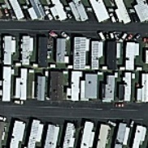
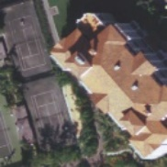
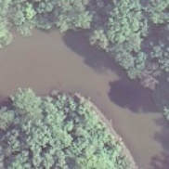
RS Image Descriptors
Query
Images in the Archive
features
features
features
B. Demir

Slide 8
RS Image Descriptors
RS Image Descriptors
Several low-level features have been presented, such as: intensity features, shape features, and texture features.
Global image representations are defined based on a set of local descriptors, such as:
Scale Invariant Feature Transform (SIFT) models portions of image around the interest points;
Local Binary Pattern (LBP);
Local Phase Quantization (LPQ).
To define the global image representations, the bag-of-visual-words representations of the local descriptors are considered.
[1] P. Maheswary and N. Srivastava, “Retrieval of Remote Sensing Images Using Colour & Texture Attribute,” IJCSIS Int. J. Comput. Sci. Inf. Secur., vol. 4, no. 2, pp. 1–5, 2009.
[2] P. Hong, Q. Tian, and T. S. Huang, “Incorporate support vector machines to content-based image retrieval with relevant feedback,” in Proc. IEEE Int. Conf. Image Process., Vancouver, BC, Canada, 2000, pp. 750–753.
[3] M. Musci, R. Q. Feitosa, G. A. O. P. Costa, M. Luiza, and F. Velloso, “Assessment of Binary Coding Techniques for Texture Characterization in Remote Sensing Imagery,” IEEE Geosci. Remote Sens. Lett., vol. 10, no. 6, pp. 1607–1611, 2013.
B. Demir

Slide 9
RS Image Descriptors
Region-based Descriptors: These descriptors are obtained by segmenting the images and each segments are represented using various features such as:
Intensity;
Shape;
Texture.
Hashing based image descriptors: Represent each image with binary code vectors.
[1] B. Chaudhuri, B. Demir, S. Member, and L. Bruzzone, “Region-Based Retrieval of Remote Sensing Images Using an Unsupervised Graph-Theoretic Approach,” vol. 13, no. 7, pp. 987–991, 2016.
[2] B. Demir and L. Bruzzone, “A Novel Active Learning Method in Relevance Feedback for Content-Based Remote Sensing Image Retrieval,” IEEE Trans. Geosci. Remote Sens., vol. 53, no. 5, pp. 2323–2334, 2015.
[3] B. Demir, L. Bruzzone, "Hashing Based Scalable Remote Sensing Image Search and Retrieval in Large Archives", IEEE Transactions on Geoscience and Remote Sensing, vol. 54, no.2, pp. 892-904, 2016.
B. Demir

Slide 10
Histogram-based features
We consider spectral histograms that model each pixel by considering marginal distributions of responses of a bank of filters based on three steps:
Step-1: Apply a sequence of filters to the RS image
X
Image
Step-2: Estimate local histograms of each sample at the j-th pixel location in images in a w×w window
Step-3: Stack the local histograms to obtain the Spectral Histogram
J. Yuan, D. Wang, R. Li, “Remote sensing image segmentation by combining spectral and texture features”, IEEE Transactions on Geoscience and Remote Sensing, vol. 52, no. 1, pp.16-24, Jan. 2014.
B. Demir

Slide 11
Scale Invariant Feature Transform
Scale-invariant feature transform (or SIFT) is an algorithm to detect and describe local features in images.
Distinctive features;
Invariant to image scale, rotation and affine distortion;
Applied locally on key-points;
Based upon the image gradients in a local neighborhood.
SIFT is in wide use both in academia and industry
Many available implementations:
Binaries available at Lowe’s website;
C/C++ open source by A. Vedaldi (UCLA);
C# library by S. Nowozin (TU-Berlin).
Lowe, D. G., “Distinctive Image Features from Scale-Invariant Keypoints”, International Journal of Computer Vision, 60, 2, pp. 91-110, 2004.
B. Demir

Slide 12
Scale Invariant Feature Transform
SIFT has 4 main steps:
Scale-space extrema detection
Keypoint localization
Orientation assignment
Keypoint descriptor
SIFT key locations are defined as maxima and minima of the result of difference of Gaussians function applied in scale space to a series of smoothed and resampled images.
Bag-of-visual-words approach is used for SIFT to model the final feature vector of an image. Thus, the final representation is the frequency or histogram of the codewords in an image.
B. Demir

Slide 13
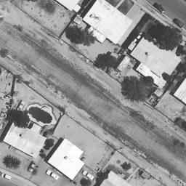
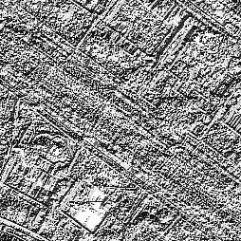
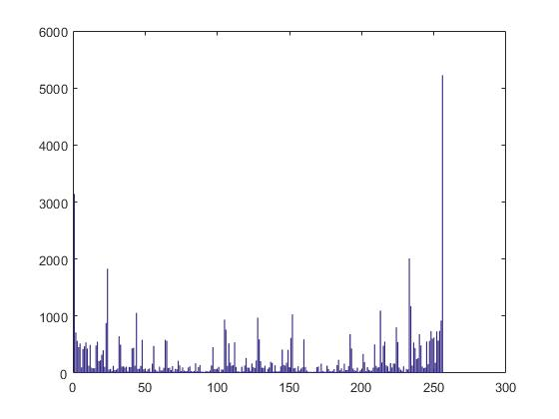

Local Binary Patterns
Recently, local pattern based descriptors have been found effective for description of the image content.
The standard LBP (sLBP) is considered among the most computationally efficient RS image descriptors in the framework of CBIR.
$$M$$
11100001
= 225
B. Demir

Slide 14
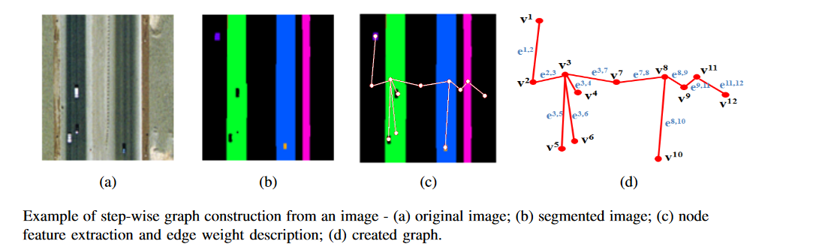
Region Based Descriptors
Shape features (which include Fourier descriptors and contour-based shape descriptors like area, convex area, perimeter, extent, solidity and eccentricity derived from the region contours);
Intensity features (which consist of the mean, standard deviation and skewness of the samples within each region in each spectral channel);
Texture features (which include entropy and spectral histogram).
B. Demir

Slide 15
Region Based Descriptors
The similarities between the query graph and the graphs of images in the archive are calculated using a novel inexact graph matching strategy that jointly consists of:
a subgraph isomorphism algorithm (which measures the similarity between graph nodes);
a spectral embedding algorithm (which measures the similarity between graph edges).
The most similar images to the query image are then retrieved according to the ranking of graph similarities.
B. Chaudhuri, B. Demir, L. Bruzzone, S. Chaudhuri, "Region-Based Retrieval of Remote Sensing Images using an Unsupervised Graph-Theoretic Approach", IEEE Geoscience and Remote Sensing Letters, vol. 13, no.7, pp. 987-991, 2016.
B. Demir

Slide 16

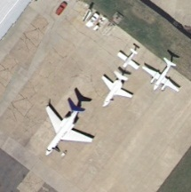
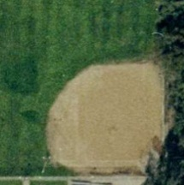
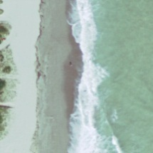
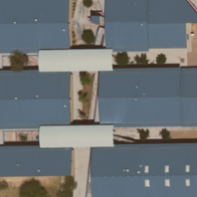
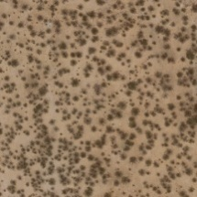
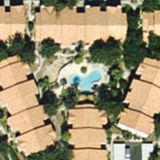
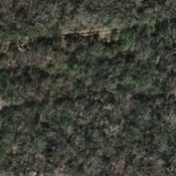
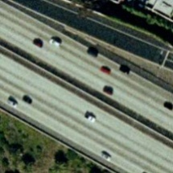
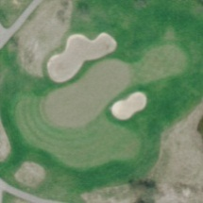
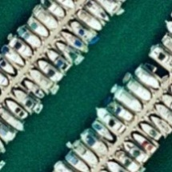
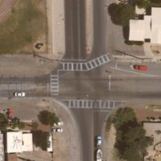
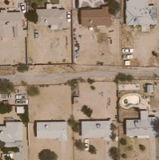
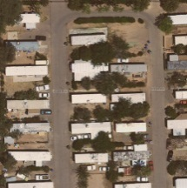
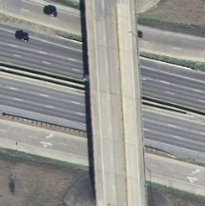
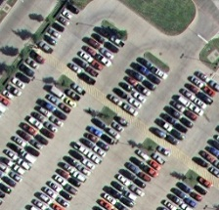
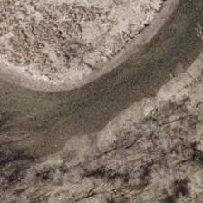
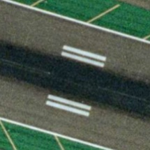
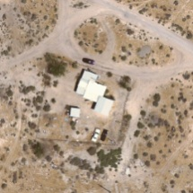
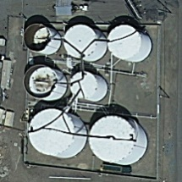
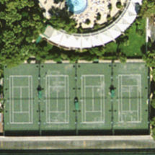
Data Set Description
Data Set Description
Data set: archive that consists of annotated images associated with 21 categories selected from aerial orthophotos with a pixel resolution of 30 cm. Each class includes 100 images that were downloaded from the USGS National Map of several US regions.
agriculture
airplanes
baseball dia.
beach
buildings
chaparral
dense-res.
forest
freeway
golf course
harbor
intersection
medium-res.
mobile-home
overpass
sparse-res.
stor. tanks
parking lot
river
runway
tennis courts
Y. Yang, and S. Newsam, “Geographic image retrieval using local invariant features”, IEEE Transactions on Geoscience and Remote Sensing, vol. 51, no. 2, pp. 818-832, Feb. 2013.
B. Demir
20

Slide 17
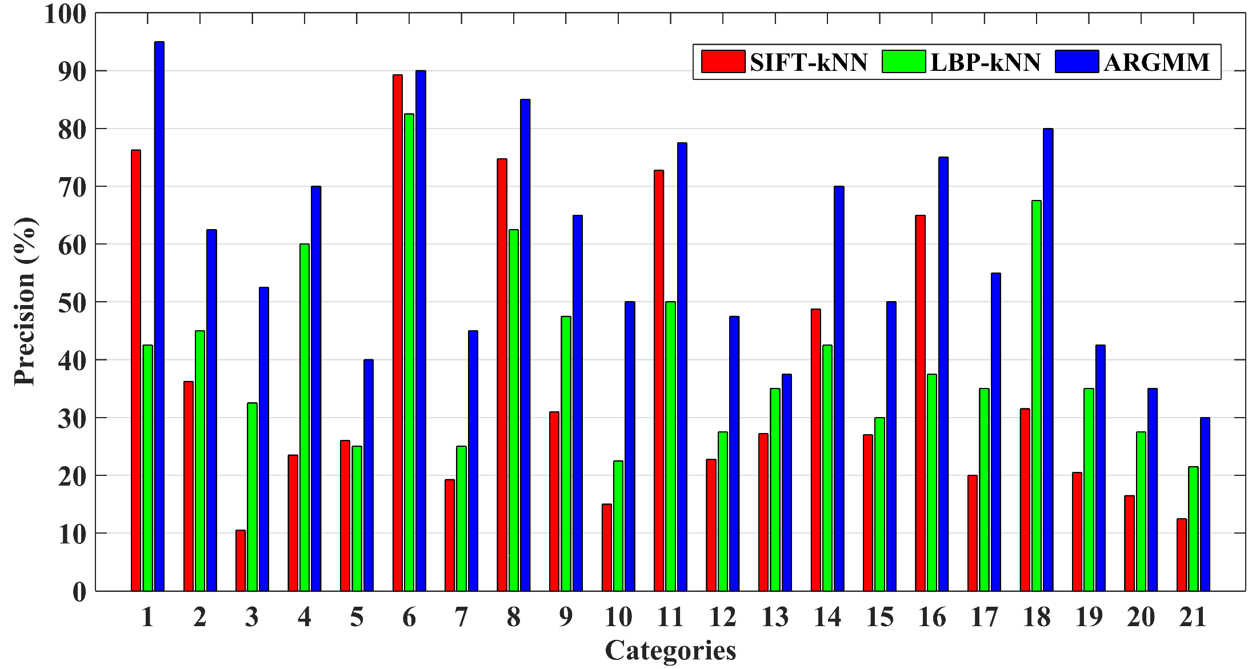
Desciptors Comparison

Slide 18
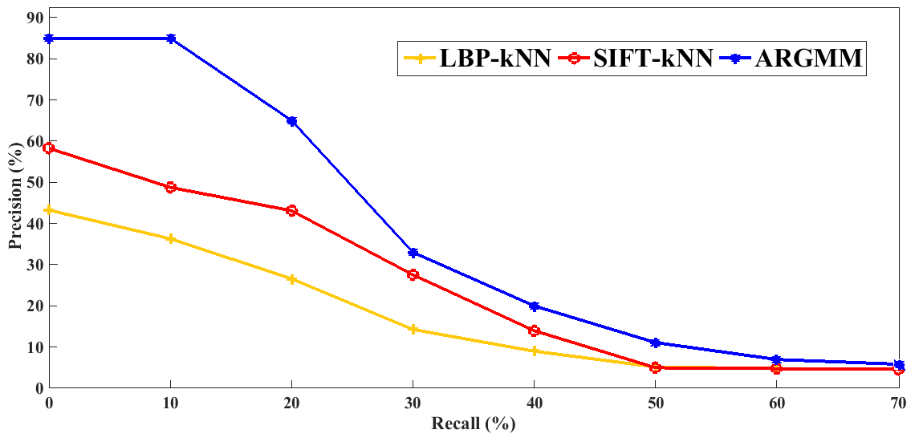
Desciptors Comparison

Slide 19
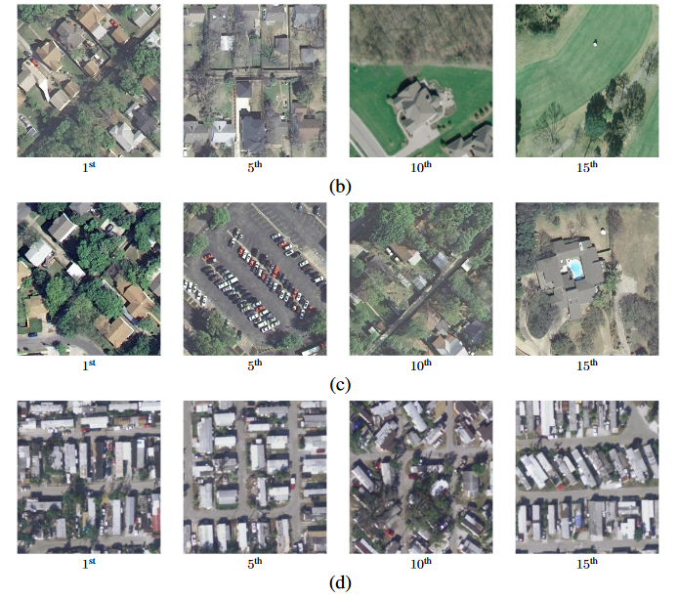
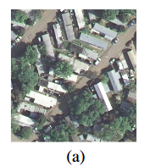
Desciptors Comparison
b) SIFT- kNN
c) LBP-kNN
d) ARGMM

Slide 20
Desciptors Comparison
Graph construction and matching requires higher computation time
However, this time can be significantly reduced by using scalable approximate graph matching algorithms. For example:
the Random Walk algorithm for approximate graph matching has shown promising results by achieving a reduction of about 5 order of magnitude in execution time on an average.
We can also exploit the high redundancy in the graph adjacency matrices and approximate them using compressed representations while performing spectral embedding.
Another method is to use cluster-based parallel computing approach in which the query graph is initially matched with the graph clusters in order to filter out the largely irrelevant images. Then, a finer search is performed within the most similar cluster to retrieve the desired images.

Slide 21
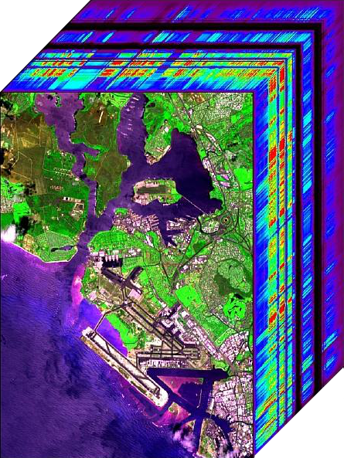
Compressed Domain Descriptors
Develop RS image search and retrieval methods and tools in compressed domain that can:
accurately characterize encoded (or partially decoded) RS images;
extract features from 2D/3D wavelet coefficients.
adapt 2D compression based methods to 3D.
2D compression methods for RS images:
Transform Coding (e.g., JPEG, JPEG-2000, EZW, SPITH)
Predictive Coding(e.g., DPCM, ADPCM)
3D compression methods for RS images:
Transform coding (e.g., 3D-SPECK, 3D SPITH, PCA+JPEG2000, DCT+JPEG2000)
Predictive coding (e.g., DPCM, CCSDS)
Pearl Harbor, Hawaii
B. Demir

Slide 22

Compressed Domain Descriptors
JPEG Image Compression
DC = { DC, DC, DC }
H = { H1, …, H5, H1, …, H5, H1, …, H5 }
V = { V1, …, V5, V1, …, V5, V1, …, V5 }
D = { D1, …, D5, D1, …, D5, D1, …, D5 }
DC = { DC, DC, DC }
H = { Hvar, Hku, Hvar, Hku, Hvar, Hku }
V = { Vvar, Vku, Vvar, Vku, Vvar, Vku }
D = { Dvar, Dku, Dvar, Dku, Dvar, Dku }
DCT coefficients used for deriving the proposed features in each band.
B. Demir

Slide 23
Compressed Domain Descriptors
JPEG 2000 Image Compression
RS Image
band
Discrete Wavelet
Transform
Tiles
Generation
Embedded Block
Code with
Optimizated
Truncation
Codestream/ Compressed Image data
LL2
HL2
CB
Tile 1
Tile 2
HL 1
LH2
HH2
Tile 3
Tile 4
LH 1
HH 1
Original Image
Subbands
Codeblocks
Bitplanes
Codestream
B. Demir

Slide 24
Compressed Domain Descriptors
WAVELET FEATURES |  | HEADER FEATURES
High frequency coefficients | Low frequency coefficients
Generalized Gaussian Density | Spectral Histogram | Bit plane histogram
Gaussian Mixture Model | Local Binary Pattern | Three pass Layer Probability signature
Generalized Gamma Density | Significance map features | Number of Zero bit planes
Extended Energy Signature | Local ternary Pattern | Entropy coded bytes
Distribution of positive wavelet coefficients | Local Tetra Pattern | Code Significance Map
GLCM | Local Derivative Pattern | Context Label Distribution
Invariant moment
Maximum Bit histogram
B. Demir

Slide 25
CBIR in RS: General Approach
Image
features
Unsupervised, e.g., k-nn…
Supervised, e.g., SVM…
Feature Extraction
Query Image
RS Image Retrieval
Data Archive
Feature Extraction
Image
features
AUX
Image Archive
Retrieved Images
B. Demir
5

Slide 26
Unsupervised CBIR
A basic and effective approach to image retrieval in multimedia is to use the k-nearest neighbor (k-nn) approach.
The k-nn algorithm achieves CBIR by:
Scanning all archive images.
Sorting them according to their similarity to the query image.
Search complexity of k-nn is O(n) and storage complexity is O(nd), where n is number of images in the archive and d is the image feature number.
B. Demir

Slide 27
Supervised CBIR
The features from an image have very limited capability in representing the image semantic content.
In order to deal with this problem relevance feedback has been introduced in CBIR, aiming at taking user’s feedback into account. The user’s feedback provides relevant and irrelevant images with respect to the query image.
Image retrieval becomes a two-class problem: relevant versus irrelevant images.
Accordingly, supervised classification approaches can be used by training the classifier with the already annotated images of two classes.
B. Demir

Slide 28
Supervised CBIR
Many techniques for classification have been presented in the literature:
regularized radial basis function neural networks,
Fisher discriminant analysis,
regularized AdaBoost .
maximum likelihood classifier,
spectral angle mapper classifier,
k-nearest neighbor classifier .
support vector machine (SVM).
SVM is found to be most effective, yielding higher accuracies than the other methods.
B. Demir

Slide 29
Kernels for the Histogram-based Features
Recent studies have shown that histogram features are very effective in many pattern recognition problems due to their:
high discrimination capability;
sparse representation.
Histogram features have recently gained an increasing interest in RS.
Due to their effectiveness, it is expected that the use of histogram features will further attract attention in the RS community.
Problem: Histogram features can result in very high-dimensional feature vectors that may lead to:
Hughes phenomenon (thus poor generalization ability on classification systems);
Increased computational time.
S. Maji, A.C. Berg, and J. Malik, “Efficient classification for additive kernel SVMs,” IEEE Transactions on Pattern Analysis and Machine Intelligence, vol. 35, no.1, pp. 66-77, 2013.
B. Demir

Slide 30
Kernels for the Histogram-based Features
The most popular and effective kernels presented in the computer-vision community are:
Histogram Intersection (HI) Kernel:
Chi-square ( ) kernel:
These are positive definite parameter-free kernels for histogram based features.
S. Maji, A.C. Berg, and J. Malik, “Efficient classification for additive kernel SVMs,” IEEE Transactions on Pattern Analysis and Machine Intelligence, vol. 35, no.1, pp. 66-77, 2013.
B. Demir

Slide 31
Additive Kernel Support Vector Machines
SVMs divide the L-dimensional image feature space into two subspaces, one for each class, using a linear discriminant function in the kernel space.
The decision function of SVM in the kernel space is given by:
A kernel is additive if it can be written as:
The resulting SVM decision function is also additive.
number of SVs
kernel function
Lagrange multiplier
kernel function for the
l-th feature only
number of features
B. Demir
B. Demir

Slide 32
Additive Kernel Support Vector Machines
AK-SVM is additive since:
Additive Kernel
Change the order of summations
S. Maji, A.C. Berg, and J. Malik, “Efficient classification for additive kernel SVMs,” IEEE Transactions on Pattern Analysis and Machine Intelligence, vol. 35, no.1, pp. 66-77, 2013.
B. Demir
B. Demir
Notes:
Solution: Develop a novel system that is defined on the basis of two steps:
low-cost definition of a training set for the target domain with TL and AL methods; and
target domain classification according to the Bayesian cascade decision rule.

Slide 33
Computational Complexity of AK-SVMs
To classify a sample, n kernel computations are needed.
Let us assume that the kernels can be computed with a complexity given by O(L), where L is the number of features.
The computational complexity of the classification phase of the AK-SVM is O(Ln).
Thus, if the value of n high, the computational complexity of AK-SVM classification increases.
B. Demir

Slide 34
Fast Implementations of AK-SVMs
Fast implementations of the AK-SVM in the case of HI kernel:
With HI Kernel
Sort SVs in increasing order with corresponding α values and labels
Find largest r index such that
Change the order of summations
These parts are independent from
B. Demir
B. Demir
Notes:
Solution: Develop a novel system that is defined on the basis of two steps:
low-cost definition of a training set for the target domain with TL and AL methods; and
target domain classification according to the Bayesian cascade decision rule.

Slide 35
Fast Implementations of AK-SVMs
These parts can be pre-computed only once
Fast Exact Implementations of the AK-SVM with HI Kernel:
can be computed with a significantly reduced complexity O(m×log(n));
AK-SVM with HI kernel can be implemented with a speed up of O(n/log(n)) without any loss in the classification accuracy.
Fast Approximate Implementation of AK-SVM with HI Kernel:
The final discrimination function can be estimated by approximating each dimension independently.
Piecewise linear polynomial approximation can be used.
Computational complexity is similar to the linear SVM.
S. Maji, A.C. Berg, and J. Malik, “Efficient classification for additive kernel SVMs,” IEEE Transactions on Pattern Analysis and Machine Intelligence, vol. 35, no.1, pp. 66-77, 2013.
B. Demir
B. Demir
Notes:
Solution: Develop a novel system that is defined on the basis of two steps:
low-cost definition of a training set for the target domain with TL and AL methods; and
target domain classification according to the Bayesian cascade decision rule.

Slide 36
Fast Implementations of AK-SVMs
By keeping the advantages of non-linear SVMs, the AK-SVMs provide more accurate classification results than linear SVMs with a similar computational complexity.
Additive Kernel
Non-Linear SVMs
Evaluation time
Linear SVM
AK-SVM
Accuracy
B. Demir
B. Demir

Slide 37






How to Achieve Multi-label Image Retrieval
dock, ship, water
buildings, cars, grass, pavement, trees
buildings, cars, grass, pavement, trees
bare soil, buildings, grass, pavement
cars, pavement, trees
sand, sea
B. Demir

Slide 38
CBIR in RS-Problem Definition
Low-level features from an image have very limited capability in representing and analyzing the semantic content of RS images.
Problem: the semantic gap occurs between low-level features and high-level concepts and leads to poor CBIR performance.
Search complexity is O(n) and storage complexity is O(nd), where n is number of images in the archive and d is the image feature number.
Considering remote sensing image archives, CBIR becomes computationally time-demanding when the number of images n in the archive is very large.
Problem: exhaustive search in huge remote sensing archives is difficult with available algorithms.
B. Demir
6

Slide 39
1- Semantics-intensive Interactive Remote Sensing Image Search and Retrieval Systems
B. Demir
7

Slide 40
CBIR with Relevance Feedback
A Semantics-intensive CBIR System is defined based on an interactive relevance feedback (RF) scheme that aims at taking user’s feedback into account.
User provide relevant and irrelevant images with respect to the query image.
Retrieving images can be modeled as a two-class classification problem: relevant versus irrelevant images.
However, annotating images as relevant or irrelevant by a user is time consuming and thus costly.
To overcome with this problem, Active Learning (AL) methods are introduced to drive RF in the framework of CBIR.
B. Demir
8

Slide 41
CBIR with RF driven by Active Learning
Set of relevant and
irrelevant images
Archive
Update the Set
of Relevant and Irrelevant Images
Binary
Classifier
Yes
Convergence?
User Annotation
No
Retrieved
images
AL function
M. Ferecatu and N. Boujemaa, “Interactive remote-sensing image retrieval using active relevance feedback,” IEEE Trans. Geosci. Remote Sens., vol. 45, no. 4, pp. 818–826, Apr. 2007
B. Demir
9

Slide 42
CBIR with RF driven by Active Learning
AL has gained a significant interest in the last years particularly for the remote sensing image classification.
However, AL methods defined for classification problems can not be directly used in CBIR due to:
imbalanced training set;
very few training samples in CBIR problems.
Accordingly, the boundary between two classes is relatively inaccurate particularly at the first iterations of AL and thus a reliable modeling of the problem is challenging.
AL methods that can overcome the above-mentioned problems are recently introduced for the retrieval of remote sensing images.
B. Demir
10
Notes:
42

Slide 43
Triple criteria AL Method for RF
The Triple Criteria Active Learning (TCAL) method in the context of Support Vector Machine (SVM) classifier to drive RF in CBIR:
Defines a set of relevant and irrelevant images with respect to the query image as small as possible.
Retrieves the images with high performance and small number of iterations.
Selects images according to three criteria:
Uncertainty;
Diversity;
Density.
B. Demir, L. Bruzzone, "A Novel Active Learning Method in Relevance Feedback for Content Based Remote Sensing Image Retrieval", IEEE Transactions on Geoscience and Remote Sensing, vol. 53, no.5, pp. 2323– 2334, 2015.
B. Demir
11
Notes:
43

Slide 44
TCAL Method: Block Scheme
Step 1
Step 2
SVM
Training
Margin Sampling
Kernel k-means Clustering
Estimation of Cluster Densities
Selection of the Most Representative Sample of Each Cluster
It is implicitly assumed that images are represented according to an appropriate set of features.
B. Demir
12

Slide 45
TCAL Method: First Step
The most uncertain q images are selected according to the margin sampling strategy.
A qualitative example:
H
Unlabeled image features
M. Ferecatu and N. Boujemaa, “Interactive remote-sensing image retrieval using active relevance feedback,” IEEE Trans. Geosci. Remote Sens., vol. 45, no. 4, pp. 818–826, Apr. 2007
13
B. Demir

Slide 46
TCAL Method: First Step
The most uncertain q images are selected according to the margin sampling strategy.
A qualitative example:
H
The selected uncertain
image features when q=12:
Unlabeled image features
Selected uncertain image features
M. Ferecatu and N. Boujemaa, “Interactive remote-sensing image retrieval using active relevance feedback,” IEEE Trans. Geosci. Remote Sens., vol. 45, no. 4, pp. 818–826, Apr. 2007
14
B. Demir

Slide 47
TCAL Method: Second Step
The second step is devoted to select h images that are diverse and are associated to high density regions of the image feature space among the q uncertain ones.
The density and diversity of images are assessed on the basis of a novel clustering based approach applied in the kernel space where SVM separating hyperplane operates.
Clustering is an effective way to assess the diversity and density of samples as the patterns within the same cluster are correlated and vice versa.
Accordginly, the kernel k-means clustering is initially applied to uncertain images , and these images are divided into k clusters ( ) in the kernel space.
15
B. Demir

Slide 48
TCAL Method: Second Step
The density of each image in the kernel space is estimated by its average distance to all the other images located in the same cluster:
The image from the highest density region of the feature space is selected from each cluster:
The diversity of images is taken into account by selecting only one image from each cluster.
density of i-th image
non-linear mapping function
selected image
B. Demir
16

Slide 49
TCAL Method: Second Step
The selected uncertain image features when q=12:
H
Selected uncertain image features
17
B. Demir

Slide 50
TCAL Method: Second Step
Clustering results when k=h=3:
H
Selected uncertain image features
B. Demir
18

Slide 51
TCAL Method: Second Step
Diverse image features selection from high density regions in the archive:
H
Selected uncertain image features
Final selected image features
19
B. Demir

Slide 52
Data Set Description
Data Set Description
Data set: archive that consists of annotated images associated with 21 categories selected from aerial orthophotos with a pixel resolution of 30 cm. Each class includes 100 images that were downloaded from the USGS National Map of several US regions.
agriculture
airplanes
baseball dia.
beach
buildings
chaparral
dense-res.
forest
freeway
golf course
harbor
intersection
medium-res.
mobile-home
overpass
sparse-res.
stor. tanks
parking lot
river
runway
tennis courts
Y. Yang, and S. Newsam, “Geographic image retrieval using local invariant features”, IEEE Transactions on Geoscience and Remote Sensing, vol. 51, no. 2, pp. 818-832, Feb. 2013.
B. Demir
20

Slide 53
Experimental Setup
Images are modeled by bag-of-visual-words representation of the local invariant features extracted by the scale invariant feature transform (SIFT)[1].
Retrieval accuracy is computed as the average on 30 trials.
In the experiments 5 images are added to the training set at each iteration of the AL process.
Initial training set includes two relevant and three irrelevant images.
Results achieved with the TCAL method are compared with those obtained with the random sampling and the standard AL method presented in [2].
[1] Y. Yang, and S. Newsam, “Geographic image retrieval using local invariant features”, IEEE Trans. Geosci. Remote Sens., vol. 51, no. 2, pp. 818-832, Feb. 2013.
[2] M. Ferecatu and N. Boujemaa, “Interactive remote-sensing image retrieval using active relevance feedback,” IEEE Trans. Geosci. Remote Sens., vol. 45, no. 4, pp. 818–826, Apr. 2007
B. Demir
21
Notes:
53

Slide 54

Experimental Results
Experimental Results
Retrieval of images when the query image belongs to the forest category
Proposed
Standard
Random
B. Demir
22
Notes:
54

Slide 55








Experimental Results
_{Forest}
_{Forest}
_{Forest}
_{River}
_{Forest}
_{1st}
_{8th}
_{11th}
_{17th}
Proposed
_{Precision=95%}
Query
Image
_{Forest}
_{Golf course}
_{River}
_{River}
@9th RF iteration
_{1st}
_{8th}
_{11th}
_{17th}
Standard
_{Precision=85%}
B. Demir
23
Notes:
Add something about total number of available training samples
55

Slide 56

Experimental Results
Experimental Results
B. Demir
24

Slide 57
Pros and Cons
The TCAL method is promising as
it is optimized for the CBIR process and robust to biased (poor) initial set of relevant and irrelevant images;
it provides accurate retrieval accuracy;
it reduces the number of iteration required to reach high performance, and thus the total annotation time.
Similar to all AL methods presented in RS, it assumes that each image in the archive is categorized under a single label (which is associated to a land-cover class) and thus not suitable for multi-label RS image classification problems.
B. Demir
25

Slide 58
2- Scalable and Accurate Content Based Retrieval of Remote Sensing Images
B. Demir
26

Slide 59

Hashing Methods in Image Retrieval
Hashing Methods in Image Retrieval
Hash functions
P-th image
in the archive
[1] B. Demir, L. Bruzzone “Hashing based scalable remote sensing image search and retrieval in large archives”, IEEE Transactions on Geoscience and Remote Sensing, vol. 54, no.2, pp. 892-904, 2016.
B. Demir
27

Slide 60
Hashing Methods in Image Retrieval
Locality Sensitive Hashing (LSH): popular unsupervised hashing method that takes random projections of data and quantizes each projection with few bits.
Hash function of the LSH method:
total number of
hash functions
i-th image
in the archive
is a random vector generated from a multivariate Gaussian (with zero mean and identity covariance matrix) of the same dimension as the input
r-th hash
function
-1
1
-1
Query image
Qualitative Example for the case of b is 3
1
-1
1
B. Demir
28

Slide 61
Kernel-based Hashing Methods
Two main methods that define hash functions in the kernel space:
kernel-based unsupervised LSH hashing method (hash functions are defined by using only unlabeled images) [1].
kernel-based supervised hashing LSH method (semantic similarity is used to define much distinctive hash functions) [2].
Kernel-based methods express the Gaussian random vector as the weighted sum of m images selected from the archive as:
Then the hash function becomes:
nonlinear mapping function
r-th hash
function
kernel
function
[1] B. Kulis and K. Grauman, “Kernelized locality-sensitive hashing,” IEEE Transactions on Pattern Analysis and Machine Intelligence, vol. 34, no. 6, pp. 1092 – 1104, 2012.
[2] W. Liu, J. Wang, R. Ji, Y.-G. Jiang, and S.-F. Chang, “Supervised hashing with kernels”, Conference on Computer Vision and Pattern Recognition, Rhode Island, USA, 2012.
B. Demir
29

Slide 62
Supervised Kernel-Based LSH
Let us assume that a labeled training set made up of l annotated images is available.
The supervised KSLSH method defines hash functions such that:
hamming distances from similar images are minimized and those from dissimilar images are maximized.
the same hash bits for similar images are generated while obtaining different hash bits for dissimilar images.
A pairwise label matrix that shows similarity of image pairs in labeled training set is generated:
The hamming distances between images in and the labels in are correlated.
B. Demir
30

Slide 63
Supervised Kernel-Based LSH
The hash code matrix that includes the hash codes of all training images is constructed :
In order to learn the hash codes of the l labeled images in the following optimization problem is defined:
After substituting in the optimization function, we obtain the analytical form of the objective function:
After estimating , the hash functions are applied to images in the archive and hash codes of images are obtained.
frobenius norm
kernel similarity matrix between
m selected samples and the l-labeled training samples
B. Demir
31

Slide 64
Data Set Description
Data Set Description
Data set: archive that consists of annotated images associated with 21 categories selected from aerial orthophotos with a pixel resolution of 30 cm. Each class includes 100 images that were downloaded from the USGS National Map of several US regions.
agriculture
airplanes
baseball dia.
beach
buildings
chaparral
dense-res.
forest
freeway
golf course
harbor
intersection
medium-res.
mobile-home
overpass
sparse-res.
stor. tanks
parking lot
river
runway
tennis courts
Y. Yang, and S. Newsam, “Geographic image retrieval using local invariant features”, IEEE Transactions on Geoscience and Remote Sensing, vol. 51, no. 2, pp. 818-832, Feb. 2013.
B. Demir
32

Slide 65
Experimental Setup
Images are modeled by bag-of-visual-words representation of the local invariant features extracted by the scale invariant feature transform (SIFT).
The final representation of images is the histogram with 150 features.
In all the experiments Histogram Intersection Kernel is used, which is defined as:
The values of m is set to 105, whereas those of b hash bits are varied as 8 and 24.
5 relevant and 5 irrelevant images are selected to define the training set used with the KSLSH method.
i-th image
in the archive
Y. Yang, and S. Newsam, “Geographic image retrieval using local invariant features”, IEEE Trans. Geosci. Remote Sens., vol. 51, no. 2, pp. 818-832, Feb. 2013.
B. Demir
33
Notes:
Results achieved with the proposed method are compared with:
randam sampling to define an initial training set;
standard Marginal-Entropy based AL technique, ignoring temporal correlation;
the single date Bayesian maximum posterior probability classifier.
65

Slide 66

Experimental Results: Forest Category
Average Precision (20 trials) and retrieval time (in seconds) obtained by k-nn and presented KULSH and KSLSH methods when top-20 images are retrieved
All the experiments are implemented via MATLAB® on a standard PC with Intel Core i7 CPU 2.93GHz, 8GB RAM.
B. Demir
34

Slide 67

























Experimental Results: Forest Category
Linear Scan
_{Forest}
_{Chaparral}
_{Forest}
_{Chaparral}
_{Parking Lot}
_{Parking Lot}
_{Forest}
_{Chaparral}
_{AP=67%}
_{1st}
_{2nd}
_{3rd}
_{4th}
_{13th}
_{22th}
_{31th}
_{39th}
Unsupervised Kernel-Based LSH
_{Forest}
_{Forest}
_{Forest}
_{Forest}
_{Forest}
_{Chaparral}
_{Parking Lot}
_{River}
_{AP=67%}
Query
Image
_{1st}
_{2nd}
_{3rd}
_{4th}
_{13th}
_{22th}
_{31th}
_{39th}
Supervised Kernel-Based LSH
_{Forest}
_{Forest}
_{Chaparral}
_{Forest}
_{Forest}
_{Forest}
_{Forest}
_{Forest}
_{AP=85%}
_{1st}
_{2nd}
_{3rd}
_{4th}
_{13th}
_{22th}
_{31th}
_{39th}
B. Demir
35

Slide 68
Pros and Cons
These hashing methods are promising in RS for CBIR problems as:
They allow sub-linear time approximate similarity search with a high retrieval accuracy;
binary codes store efficiently the image information;
binary codes allows to compute similarity between images with a small amount of calculations.
The presented solution provides the search complexity of O(log(n)) and the storage complexity of O(nb), where b is the number of hash bits.
B. Demir
36

Slide 69
Pros and Cons
Hashing: Remote sensing images are represented by binary codes:
Query
Images in the Archive
features
features
features
1 1 1 -1 -1
1 -1 1 -1 1
-1 1 1- 1 1
Problem: Representing a RS image with a single feature vector, thus with a single hash code, may result in inaccurate retrieval results, particularly when high-level semantic content is present in the query images.
B. Demir, L. Bruzzone “Hashing based scalable remote sensing image search and retrieval in large archives”, IEEE Transactions on Geoscience and Remote Sensing, vol. 54, no.2, pp. 892-904, 2016.
B. Demir
37

Slide 70
Supervised Multi-Code Hashing
Aim: Develop a hashing method that accurately models the primitives in the definition of hashing functions.
Assumption: A small set of annotated images with region labels is available.
Proposed solution: Define a class-sensitive hashing method that:
represents each image with distinctive class sensitive multi-hash codes;
accurately characterizes primitives present within the RS images;
can be integrated with any kind of hashing method available in the literature.
T. Reato, B. Demir, L. Bruzzone "A Novel Class Sensitive Hashing Technique for Large-Scale Content-Based Remote Sensing Image Retrieval”, SPIE Image and Signal Processing for Remote Sensing, Poland, 2017
B. Demir
38

Slide 71
Supervised Multi-Code Hashing
STEP 1
STEP 2
Characterize images by descriptors of primitive classes
Transform the descriptors to multi-hash codes
STEP 3
Retrieve Images based on multi-hash codes
Characterize query image by descriptors of primitive classes
Transform the descriptors to multi-hash codes
B. Demir
39

Slide 72
Multi-Code Hashing: Step 1
Extract image regions through segmentation
Compute regions’ descriptors for each image
Construct primitive class representative
Each primitive class representative is defined as the average of training region descriptors that belong to the related class.
Extract image regions through segmentation
Each region is described by:
shape features;
texture features;
intensity features.
Any segmentation algorithm can be used, whereas in this work we have considered the parametric kernel graphs cuts algorithm.
M. Ben Salah, A. Mitiche, and I. B. Ayed, “Multiregion image segmentation by parametric kernel graph cuts,” IEEE Transactions on Image Processing, vol. 20, no. 2, pp. 545–557, 2011.
B. Demir
40

Slide 73
Multi-Code Hashing: Step 1
Extract image regions through segmentation
Compute regions’ descriptors for each image
Construct each primitive class representative
Extract image regions through segmentation
Estimate region posterior probabilities
To build an accurate correspondence between the regions and the primitive classes, are estimated as:
k-th class
B. Demir
41

Slide 74
Multi-Code Hashing: Step 1
Extract image regions through segmentation
Compute regions’ descriptors for each image
Construct each primitive class representative
Extract image regions through segmentation
Estimate region posterior probabilities
Generate primitive class descriptors
Descriptors of primitive classes are estimated as follows:
threshold
k-th class
k-th posterior probability
vector of all zero entries
B. Demir
42

Slide 75
Multi-Code Hashing: Step 2
Kernel-based supervised locality sensitive hashing (KSLSH) is applied to the descriptors of k-th primitive class separately from each other.
The KSLSH method defines hash functions such that:
hamming distances from similar descriptors are minimized and those from dissimilar images are maximized.
the same hash bits for similar descriptors are generated while obtaining different hash bits for dissimilar images.
The same process is applied for a total of b hash functions , resulting in a b-bits hash code associated to each primitive class.
B. Demir, L. Bruzzone “Hashing based scalable remote sensing image search and retrieval in large archives”, IEEE Transactions on Geoscience and Remote Sensing, vol. 54, no.2, pp. 892-904, 2016.
B. Demir
43

Slide 76

Multi-Code Hashing: Step 3
Multi-hash-code-matching scheme is used by the proposed hashing method for image retrieval.
This scheme estimates the similarity between as a sum of Hamming distances estimated between as:
Then, the images with the lowest distance are retrieved.
$$H_{C_{k}}^{X_{i}},k=1,2,...,n_{n}$$
k-th hash
code of the query image
XOR operator
k-th hash
code of the archive image
B. Demir
44

Slide 77
Archive Description
Archive: UCMERCED archive which consists of 2100 annotated aerial images, each of which associated with multiple labels (1-7 for each image). The total number of possible labels is 17.
dock, ship, water
buildings, cars, grass, pavement, trees
buildings, cars, grass, pavement, trees
bare soil, buildings, grass, pavement
cars, pavement, trees
sand, sea
B. Demir
45

Slide 78
Design of Experiments
Training set that includes 9237 region descriptors and their labels is used.
The first two steps of the multi-code hashing have been separately evaluated as:
pairwise k-nn: the similarities estimated between the descriptors of primitive classes without any hashing;
hashing: the similarities estimated between the primitive class hash codes.
Results are compared to: 1) multi-label SVM algorithm; 2) standard KLSH.
Results have been tested by varying the value of 1) hash bits number b in the range of [8-256]; and 2) threshold T in the range [0.1-0.9].
Gaussian Radial Basis Function kernel was used for the KSLSH, the ML-SVM and the proposed k-nn.
B. Demir
46

Slide 79
Experimental Results
Method |  | Recall | Time (in seconds) | Storage Complexity
Standard Single-Code Hashing | ML-SVM | 71.93 % |  | 1.640 KB
 | hashing | 59.20 % |  | 0.053 KB
Multi-Code Hashing | k-nn | 73.32 % |  | 30.140 KB
 | hashing | 69.05 % |  | 0.068 KB
b=32
All the experiments are implemented via MATLAB® on a standard PC with Intel® Xeon® CPU E5-1650 v2 @ 3.50GHz, 16GB RAM
B. Demir
47

Slide 80
Experimental Results
Method |  | Recall | Time (in seconds) | Storage Complexity
Standard Single-Code Hashing | ML-SVM | 71.93 % |  | 1.640 KB
 | hashing | 59.20 % |  | 0.053 KB
Multi-Code Hashing | k-nn | 73.32 % |  | 30.140 KB
 | hashing | 69.05 % |  | 0.068 KB
b=32
All the experiments are implemented via MATLAB® on a standard PC with Intel® Xeon® CPU E5-1650 v2 @ 3.50GHz, 16GB RAM
B. Demir
48

Slide 81
Experimental Results
Method |  | Recall | Time (in seconds) | Storage Complexity
Standard Single-Code Hashing | ML-SVM | 71.93 % |  | 1.640 KB
 | hashing | 59.20 % |  | 0.053 KB
Multi-Code Hashing | k-nn | 73.32 % |  | 30.140 KB
 | hashing | 69.05 % |  | 0.068 KB
b=32
All the experiments are implemented via MATLAB® on a standard PC with Intel® Xeon® CPU E5-1650 v2 @ 3.50GHz, 16GB RAM
B. Demir
49

Slide 82
Experimental Results
Standard Single-Code Hashing method
2nd
5th
16th
Query Image
buildings, cars, grass,
pavement, trees
buildings, cars,
pavement
pavement, sand
2nd
5th
16th
building, pavement
buildings, pavement
buildings, cars, grass,
pavement, trees
bare-soil, buildings, cars,
pavement, trees
Multi-Code Hashing method
B. Demir
50

Slide 83
Pros and Cons
The multi-code hashing method is promising for RS CBIR problems since it:
efficiently describes the complex content of RS images with multi-hash codes;
achieves fast and scalable image search and retrieval;
overcomes the limitations of the single hash codes.
Kernel based-hashing methods in general learn hash functions in the kernel space from hand-crafted features (e.g., the bag-of-visual-words based on the scale invariant feature transform) are applied to RS CBIR problems.
However, hand-crafted features may not accurately represent the high level semantic content of RS images. This leads to inaccurate retrieval results under complex RS image retrieval tasks.
B. Demir
51

Slide 84
Deep Metric and Hash-Code Learning Networks
First Stage
Pre-trained network (Inception
Net) trained on ImageNet.
ImageNet has 1.2 million images
with 1000 categories.
Intermediate image
representation is obtained from
Pool3.
Second Stage
Intermediate representation fed
to the MHCLN.
MHCLN trained from scratch
with small train set.
MHCLN learns a metric space
along with easy-to-binarize
feature representations.r
B. Demir
52

Slide 85
Deep Metric and Hash-Code Learning Networks
This network is trained using a combination of different losses, which simultaneously aim at clustering similar images while producing an easy-to-binarize final representation.
Specifically, we use the triplet loss to learn a metric space where the Euclidean distance between pair of points corresponds to the semantic distance between the corresponding images.
Moreover, we use two other losses:
a representation penalty which pushes the final network activations toward 0 and 1 and;
(2) a balancing loss which incentivizes a balanced number of 0s and 1s in
the final hashing code.
B. Demir

Slide 86

Deep Metric and Hash-Code Learning Network
A sample triplet used in training.
B. Demir
53

Slide 87

Data Set Description
B. Demir
54

Slide 88

Experimental Setup
B. Demir
55

Slide 89

Experimental Results
B. Demir
56

Slide 90

Experimental Results
B. Demir
57

Slide 91

Experimental Results
B. Demir
58

Slide 92

Conclusion and Future Directions
Fast and accurate content based image search and retrieval (CBIR) attracts increasing attention in RS.
In BigEarth we work on development of:
methods and tools to characterize and exploit high level semantic and spectral information present in remote sensing images;
feature extraction methods and tools to directly extract features from the compressed remote sensing images;
accurate and scalable remote sensing image indexing and retrieval methods together with associated tools;
multi-modal remote sensing image search and retrieval methods and tools;
a benchmark archive with high number of multi-source remote sensing images.
B. Demir
59

